Slide 1
Nanocrystalline Alloy Ribbons and Their Applications
Prof. Dr. Motoki Ohta
Global Research and Innovative Technology Center
(Professorship from Shimane University)

Slide 2
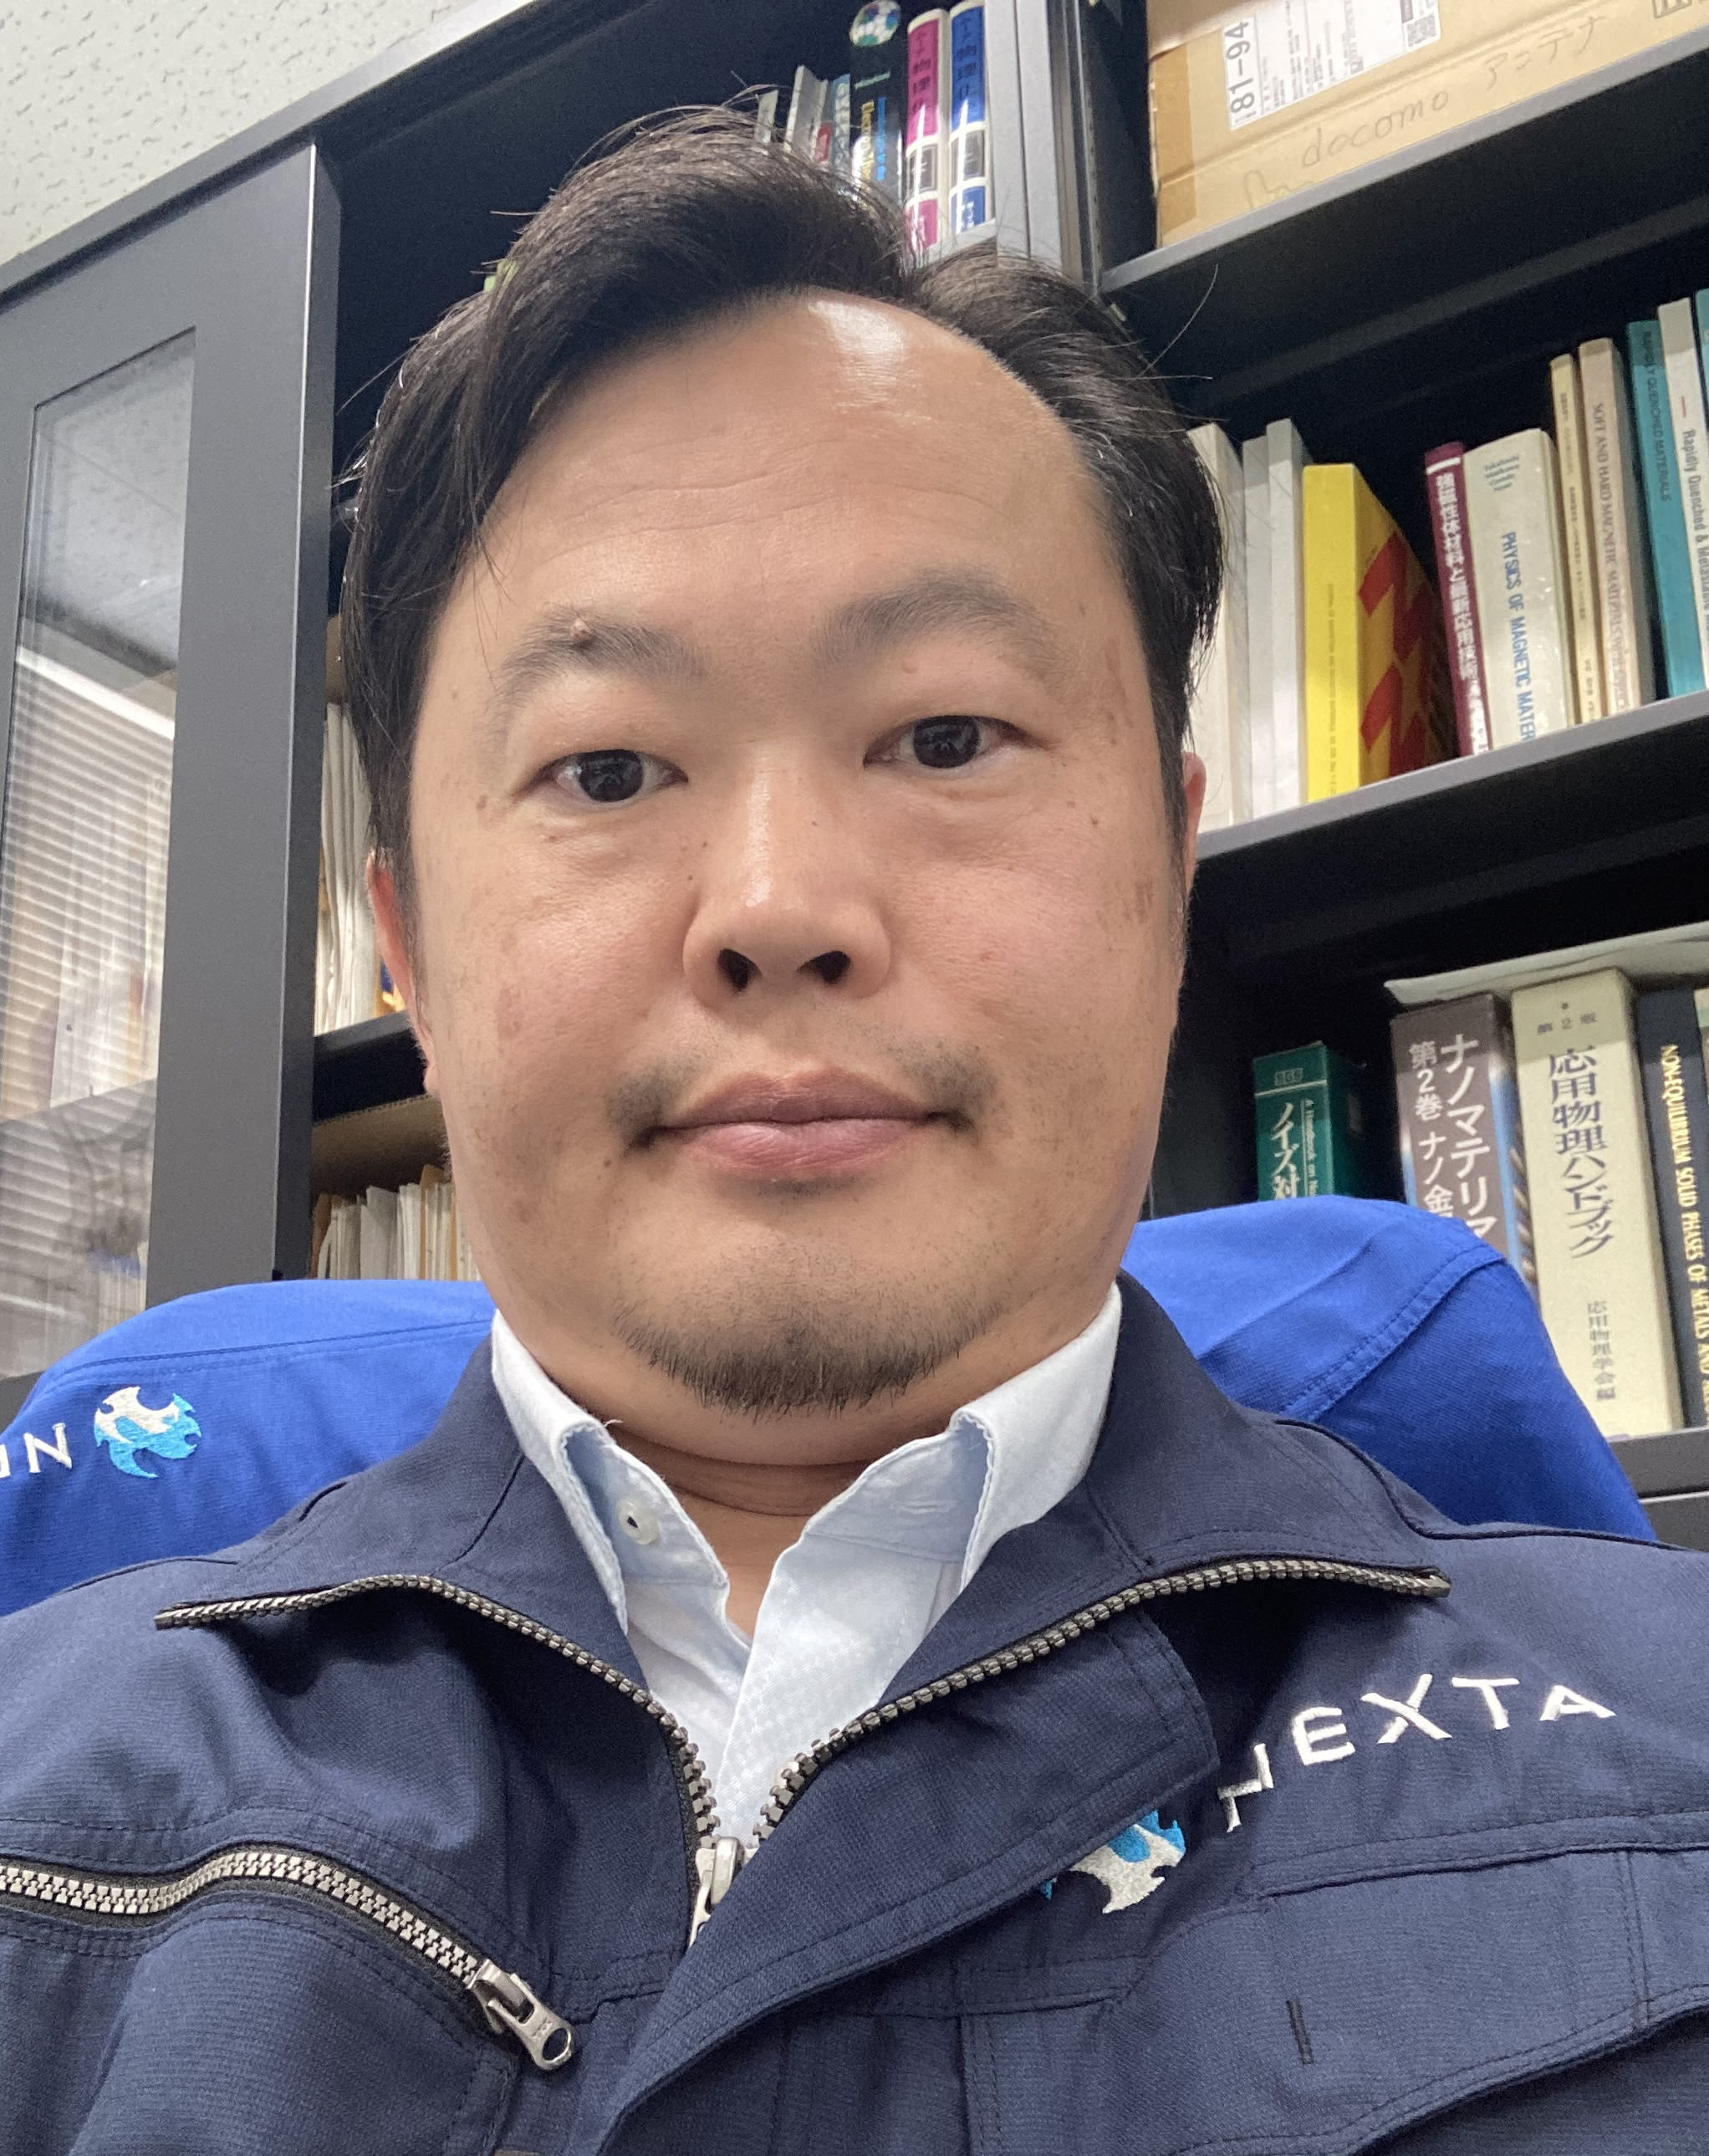
About Me
Affiliation
Senior Researcher: PROTERAL (Hitachi Metals)
Professor: Shimane University Next Generation Tatara Co-creation Center
Background
Academic degree: PhD. 2002 Tohoku University (Sendai Japan)
“Spin Fluctuation and Thermal Expansion Anomaly in Y₆(Mn_{1-x}Fe_{x})₂₃ Compounds and Amorphous Alloys”
Work History:
2002-05: Assistant Professor @ Tohoku University:
Magnetics of solid-state metals
Thermal expansion & Spin fluctuation (itinerant feature of spins)
2005-now: Researcher @ Hitachi Metals (2013-15 Metglas):
Development of rapid quenched soft magnetic materials such as nanocrystalline & amorphous ribbons
2019-now: Professorship from Shimane University:
Project Leader of the commercialization of amorphous motor
Processing and characterization of Fe-based amorphous ribbon
Motoki Ohta
My Lifework Research (relation with todays presentation)
Basically R&D person
Materials development, Soft magnetic properties
High Fe content nanocrystalline soft magnetic material (total citations: 979 google scholar)
Most cited: APL 91 (2007) 062517. (citations: 152)
Pursuit of the origin of nanocrystallization and magnetic anisotropy in FINEMET®

Slide 3
Contents
About PROTERIAL (Former Hitachi Metals)
Ideal Soft Magnetic Materials (SMMs) and
Fe-based nanocrystalline alloy FINEMET®
SMMs in medium frequencies
Development of High Fe content nanocrystalline alloys High B_{s} nanocrystalline alloy (Hi-B_{s} nano)
Applications of Hi-B_{s} nano
Remaining issues

Slide 4
Corporate Summary
We were Hitachi Metals… Now we are PROTERIL
Date of Establishment
April 10, 1956
Capital
310 million yen （as of March 31, 2023）
Representative
Sean M. Stack - Representative Director, Chairman, President and CEO
Number of Employees
Proterial, Ltd., Non-consolidated: 5,754 （as of end of March 2023)
Proterial Group, Consolidated: 26,496 （as of end of March 2023）
Revenues
Proterial Group, Consolidated: 1,118.9 billion yen （FY2022）
Number of Consolidated Subsidiaries
Japan ２３, Overseas ３８, Total ６１（as of end of March 2023）

Slide 5
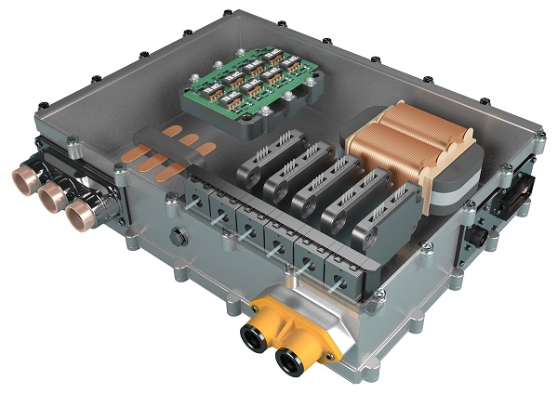
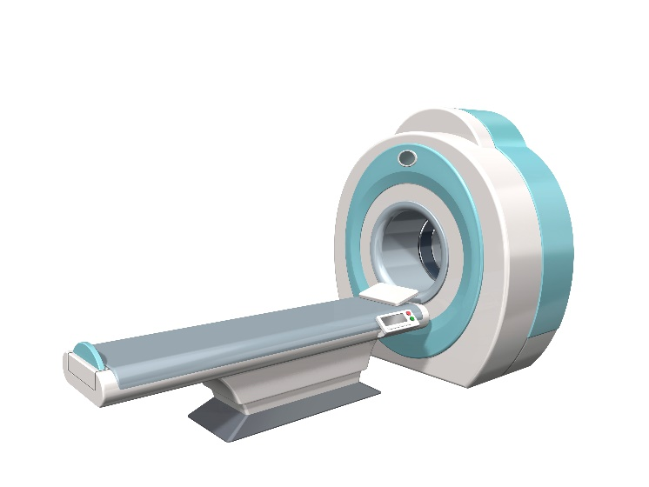
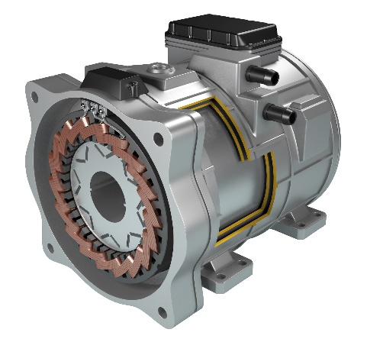
Power Electronics Materials Business Unit
Our Advanced Soft Magnetic and Ceramic Materials Contribute to Energy Conservation and ICT innovations
We offer a long list of specialty materials and components; Metglas® amorphous metals, FINEMET® nanocrystalline materials and high-performance soft ferrites and ceramics.
Insulating substrate Si₃N₄
Nanocrystalline materials FINEMET®
(Ribbon, Core、Coil)
[Inverter]
[Motor]
Ceramic Scintillator
Amorphous Magnetic Materials
for Motors
[X-ray CT]
PROTERAL HP

Slide 6

Magnetic Materials Business Unit
NEOMAX® brand, key material for industries
We boast an extensive magnet range, which includes NEOMAX® rare earth magnets and ferrite magnets, and provide our products across a wide range of fields, encompassing automobiles, electronics and home appliances. As pioneers in the field of magnetic materials, we take on the challenge of new materials and new production technologies, meeting our customers’ diverse needs and contributing to the creation of a more energy-efficient society.
Neodymium Magnets NEOMAX®
[Motor]
Ferrite Magnets NMFTM
PROTERAL HP

Slide 7
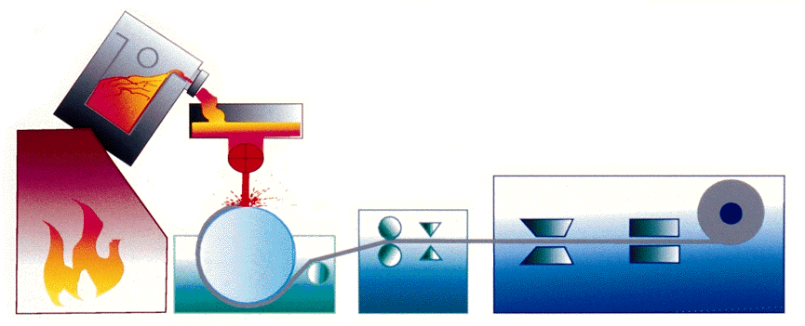
Our Rapid Quenched Products
Alloy Name | Constituent Elements | Thickness | Grain Size | Induction | Core Loss
Grain Oriented Si Steel | Fe, Si | 230 μm | ～10 mm | ◎ | △
Fe-based Amorphous | Fe, Si, B | 25 μm | ー | ○ | ○
Nano-Crystalline Alloy | Fe, Si, B, Cu, Nb | 18 μm | ～10 nm | △ | ◎
Holding Furnace
Melting
Furnace
Rapid Quenching Cast Technology (Cooling Rate: ≥10⁶℃/s )
Molten alloy is not crystallized to form alloy.
Nozzle
Casting Control
Ribbon Winder
Key Technology
Continuous
Rapid Quenching Cast
Water-cooled type Cast Roll
PROTERAL HP

Slide 8
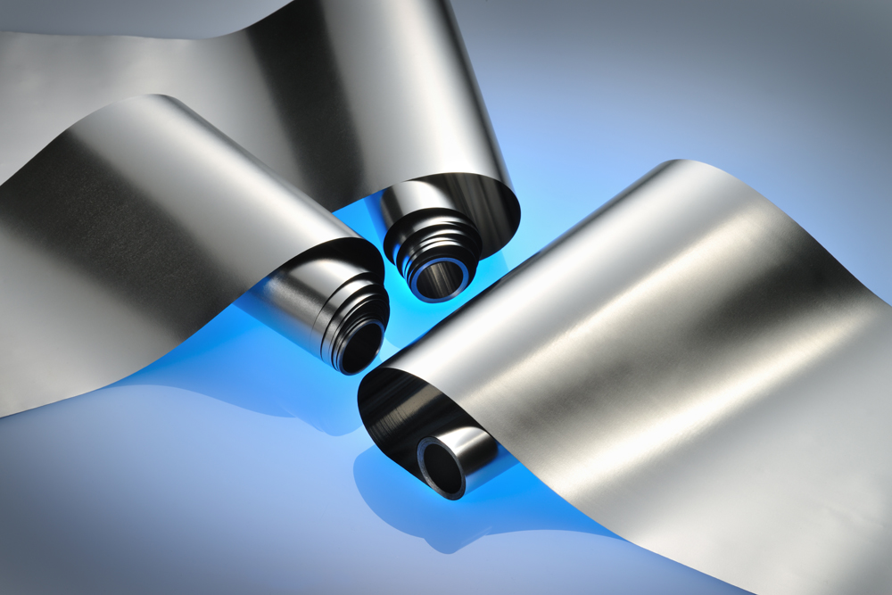
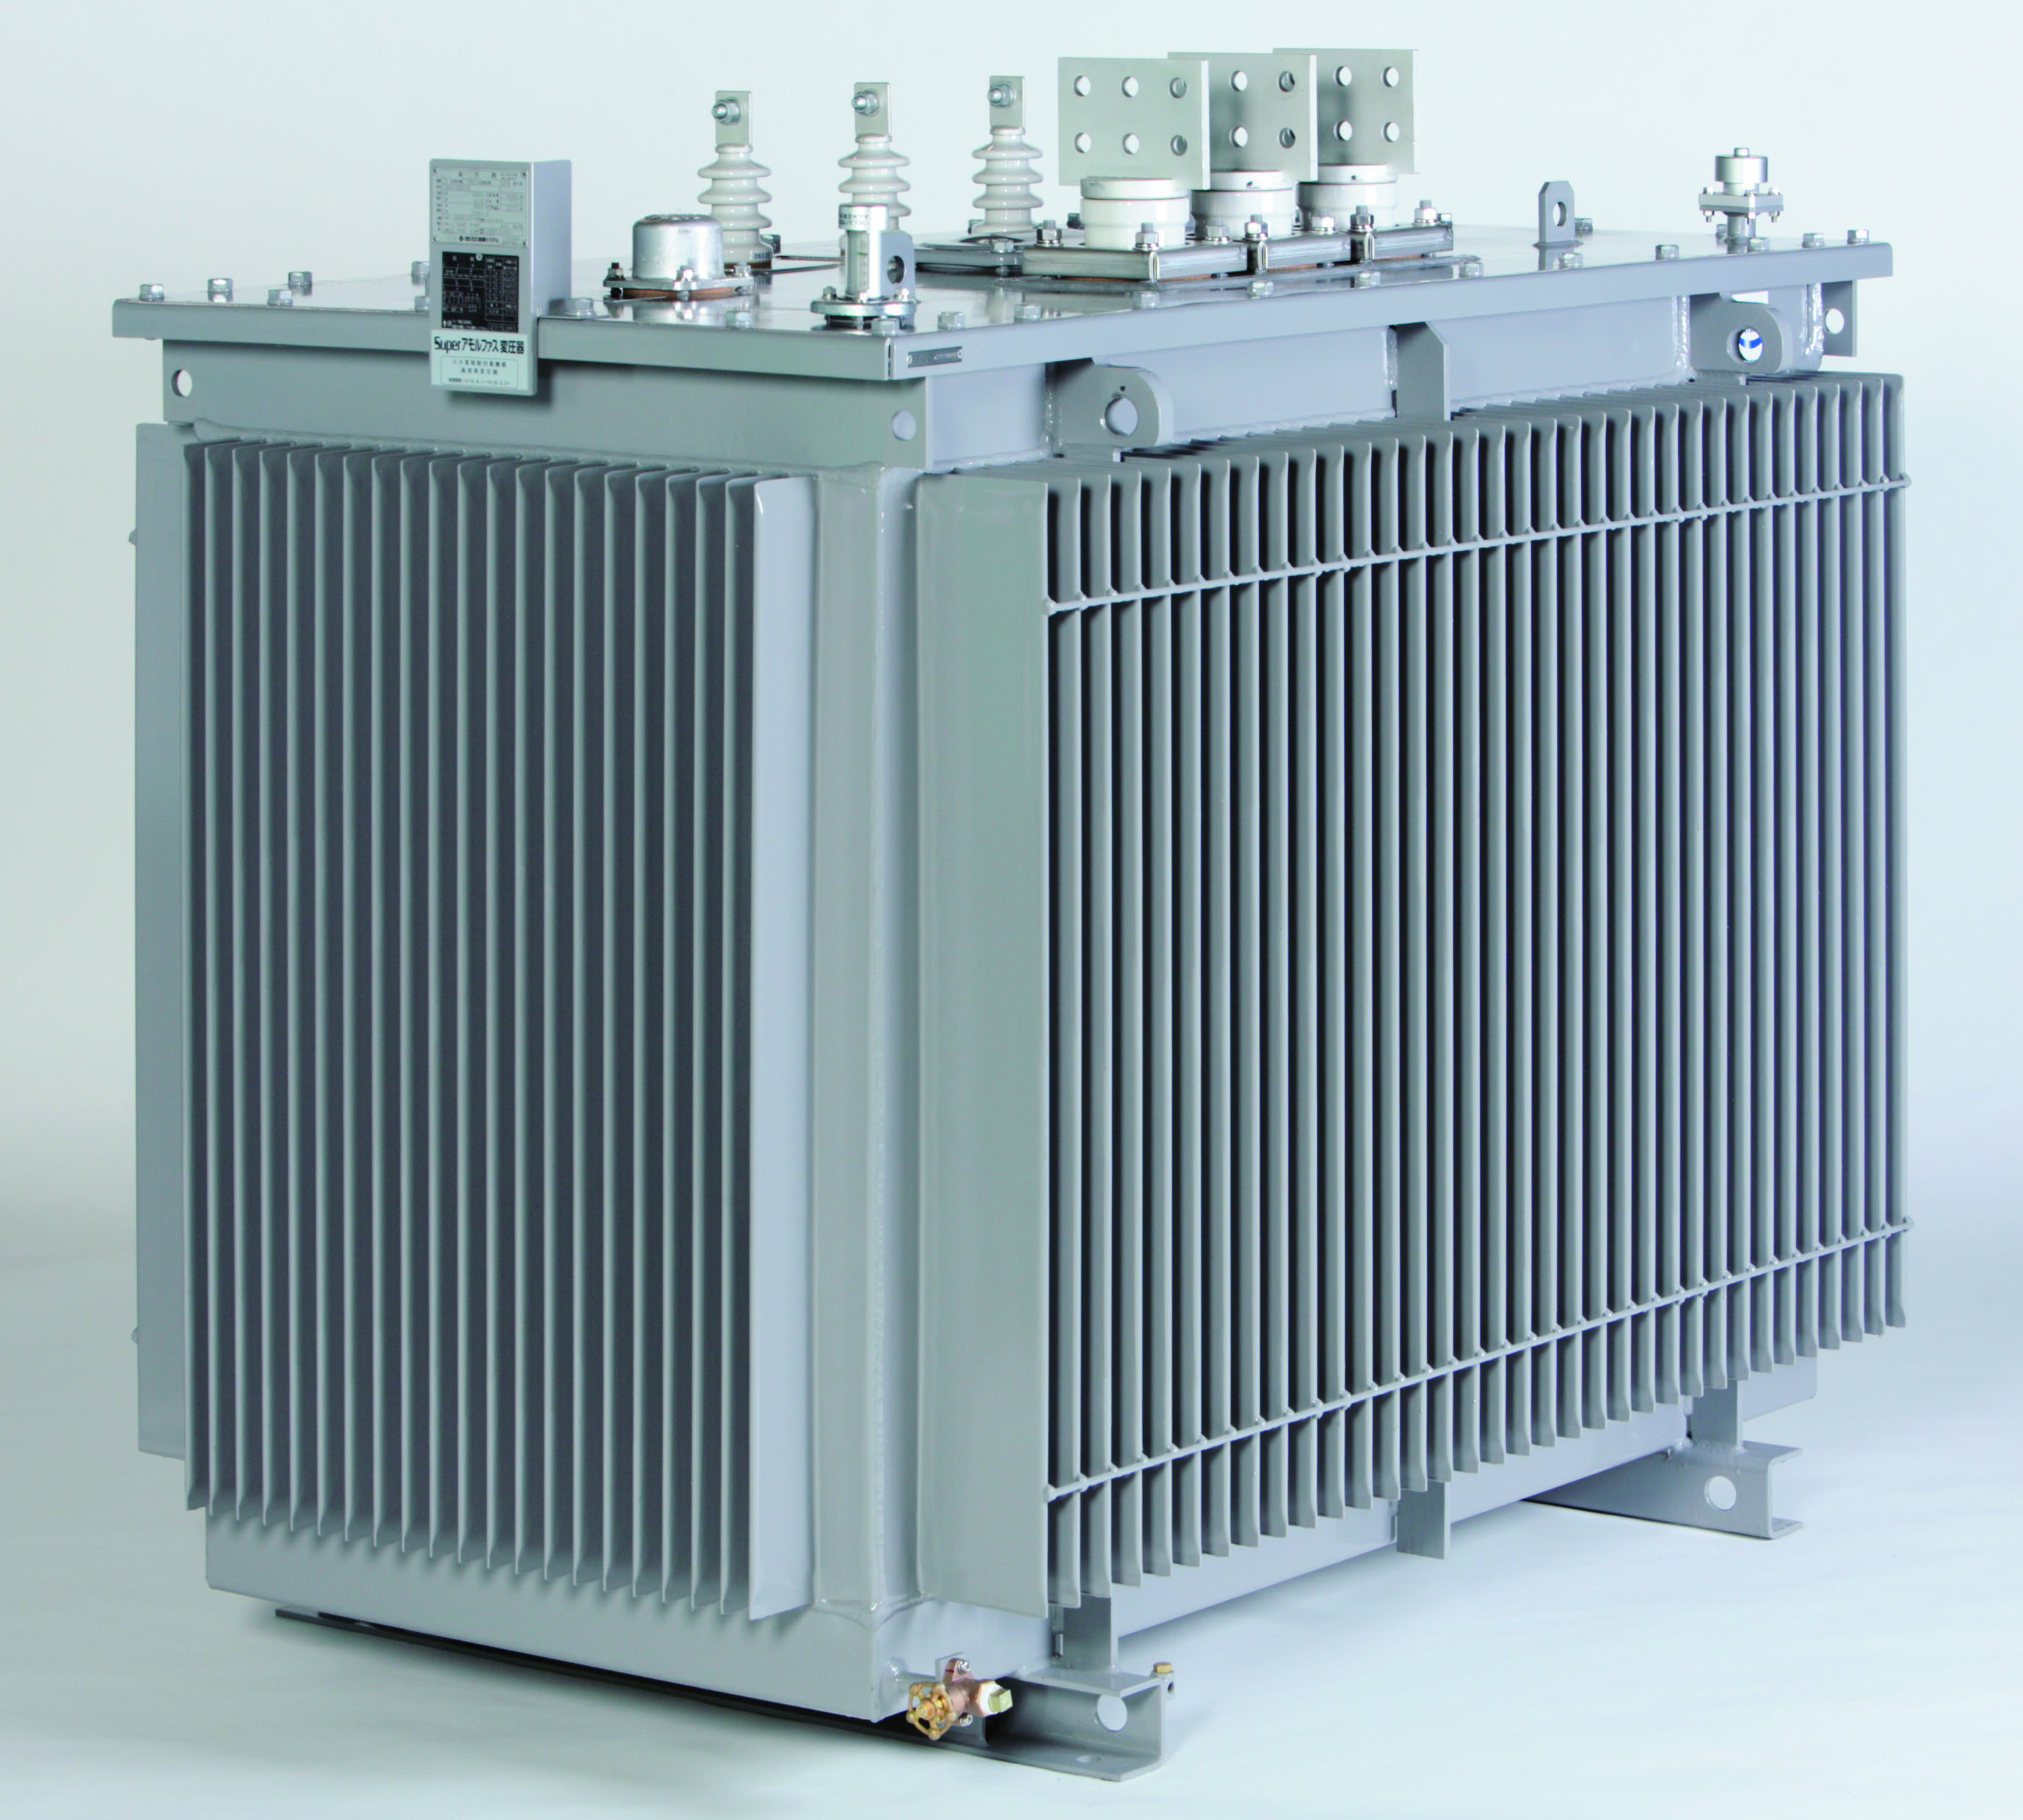
Amorphous Alloys for Transformers
Our main product for Rapid Quenching business
Amorphous Alloy for Transformer “Metglas® 2605HB1M”
Amorphous Transformer*
* Photo Credit: Hitachi Industrial Equipment System Co., Ltd.
PROTERAL HP
Notes:
8

Slide 9

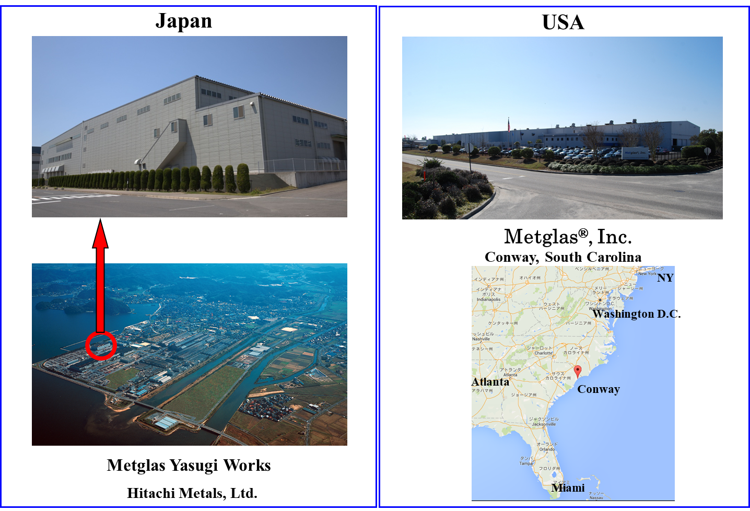
Major Bases (amorphous & nano)
■North America
Proterial America, Ltd.
Diehl Tool Steel, Inc.
Waupaca Foundry, Inc.
Ward Manufacturing, LLC
Metglas, Inc.
Proterial Cable America, Inc.
HC Queretaro, S.A. de C.V.
■Japan
Metglas Yasugi Works
Applied Components Dept.
Proterial Ferrite Electronics, Ltd.
Yasugi, Shimane
PROTERAL HP

Slide 10
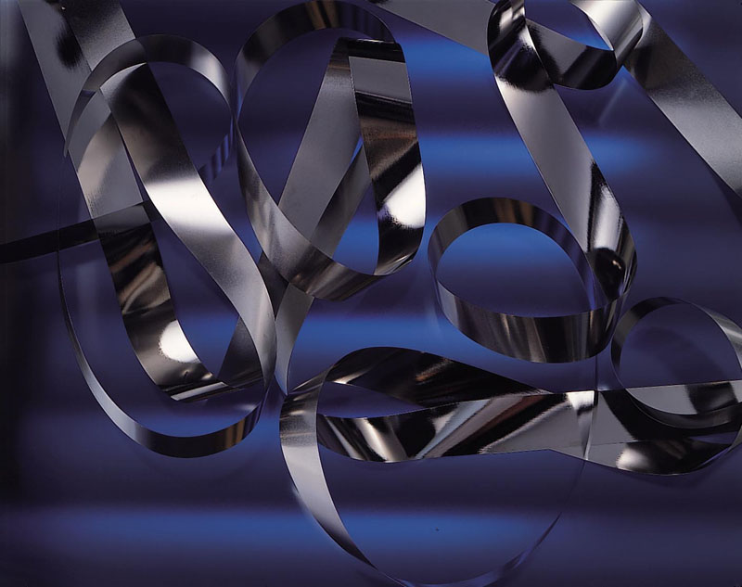
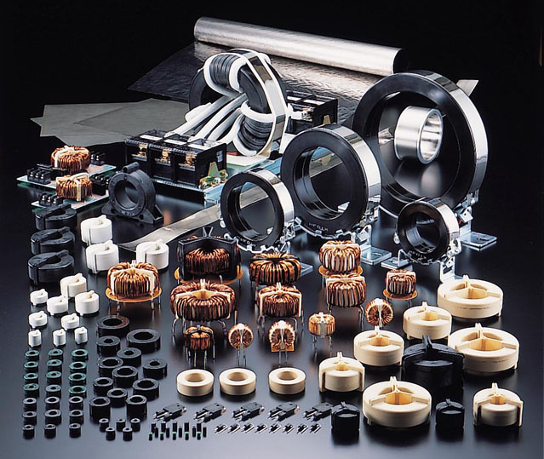
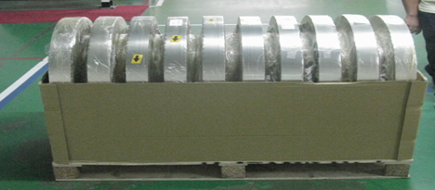
Products of Amorphous Alloy & “FINEMET®”
Nano-Crystalline Soft Magnetic Material “FINEMET®”
Application products using “FINEMET®”
Production capacity Amo & Nano total … １００kt/year (US&JP)
Item Amorphous alloy … width 142-213 mm, Thickness 0.025 mm
Nanocristillne alloy… W 50-85 mm, T 0.014-0.018 mm
1 m
1 spool = 100kg (17km)
PROTERAL HP
Notes:
10

Slide 11
Ideal Soft Magnetic Materials (SMMs) and
Fe-based nanocrystalline alloy FINEMET®

Slide 12
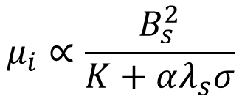
Ideal SMMs
Material-derived factors
μ: Permeability
H: Magn field
wdh: Size, dimension
(volume, cross section)
σ: Stress, Strain
K: Mag-Cry anisotropy
λ: Magnetostriction
ρ: Resistivity
E: Young’s modulus
B_{s} (M_{s}): Induction
$$μ_{i}∝\frac{B_{s}^{2}}{K+αλ_{s}σ}$$
Extrinsic factors
Intrinsic factors
(Structure,
Concertation）
μ_{i}: Initial permeability
α: coefficient
Ideal SMMs→ zero K＋ zero λ
Fe-Ni (Permalloy) Fe-Al-Si (Sendust)
Mn-Zn ferrite, Ni-Zn ferrite
Co-based amorphous alloy
Relatively low B_{s} such as max 1 T or so
Motivation of developing
Fe-based nanocrystalline alloy, the FINEMET®
Tips
non ideal soft magnetic materials are widely used if it is compatible with the usage.
Like amorphous ribbon in transformers which has High λ
However, λ is limiting its usage.
Controlling extrinsic factor to cancel the anti-factors
Notes:
軟磁性材料の要件として簡単に言ってしまえば
組成的・構造的にシンプルで当方的な材料が理想となります
軟磁性材料をめぐるエネルギーを整理するつもりで
頭に浮かんだことを線でたどって関連性を考えてみました。
かえって混乱するかもしれませんので
その場合はここは聞き流していただければと思います。
まず、材料が決まればそれに固有で決まるイントリンジックな数値があります
これがその例になります。
他方、外的因子すなわちエクストリンジックな値があります。
基本的に私たちが対象とする材料は、この両者の兼ね合いによって、その性能が再現されます。
私たちが対象とする軟磁性材料に求める要件として低損失が最重要項目ですが
損失には大きく分けて、3種類あります。
まずヒステリシス損失ですが、部材の形状が決まると反磁場が決まり、加工等で生じた応力と相まって、その材料内の磁区構造が決まります。
不可逆的磁化過程でよって B-Hループに履歴が生じ、1サイクルの損失分の損失が熱として奪われます。
この不可逆性の大きな原因になりうるのが、材料内のひずみです。
ひずみが内包された状態では磁歪定数を介して、透磁率の低下につながります。
ひずみにトラップされる形で、磁化反転起きにくくなることが、不可逆性の要因になります。
このような観点から軟磁性材料にとって低磁歪であることは非常に有利な条件となります。
また、多くの場合、加工や組み立てによって生じる軟磁気特性の劣化具合、すなわちビルディングファクターが生じますが、主たる要因は磁気弾性効果によることが多いです。
一方、この性質を逆手に取った磁歪を介した振動発電なども開発されており、悪いことばかりではないようです。
他方、この磁化過程のサイクルが繰り返される状態 すなわち交流磁場中において発生するのが渦電流損失であり、古典渦電流損失と異常渦電流損失に分類されます。
いずれも、動的な磁化過程で試料内の磁束が変化し続ける状態に対する抗力が起源で、磁束が変化するのを妨げる方向に磁束が発生し、それに伴い右ねじの法則で起電力が生じることで損失につながります。
特に異常渦電流損失は、従来といっても数十年前の話ですがの渦電流の概念では考えられていなかった磁化方向に直交する磁壁の移動に伴う損失で、原因不明だったために異常渦損と言われていました。
いずれの場合も電流を抑制することで損失を下げられるため、電気抵抗が高いことは有効と言えます。
形状的に渦損を抑えることは理にかなった方法と言えますが、例えば、薄く・小さくするのは渦損を抑えるためには有利に働くが ヒステリシス損失的には不利なので、目的や使用周波にあった形状選定は重要です。

Slide 13
Magnetic Properties Comparison of Various Materials
10⁶
Frequency=1 kHz
High Efficiency
Co-based Amorphous Alloy
Nano-Crystalline Material “FINEMET®”
10⁵
Permalloy
Fe-Al-Si Alloy
Fe-based Amorphous Metglas®
10⁴
Permeability μ_{ri}( kHz)
Si-Steel
Mn-Zn Ferrite
10³
0
0.5
1.0
1.5
2.0
2.5
Downsizing
Saturation Induction B_{s} (T)

Slide 14
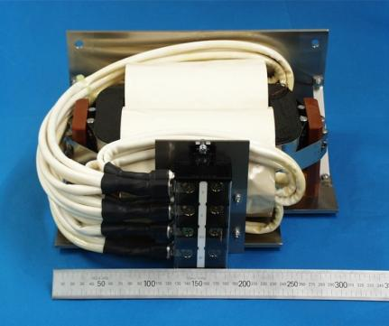
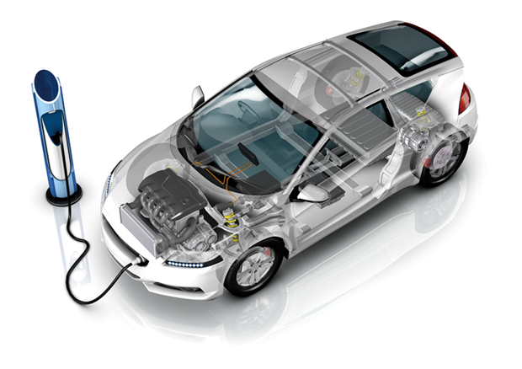
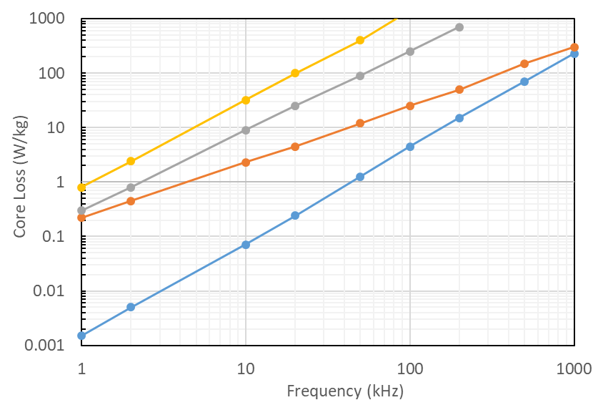
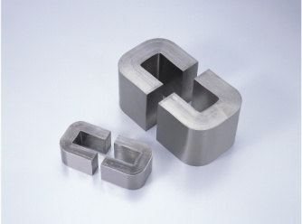
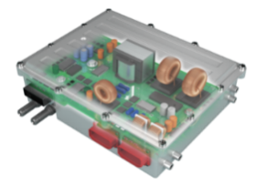
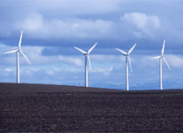
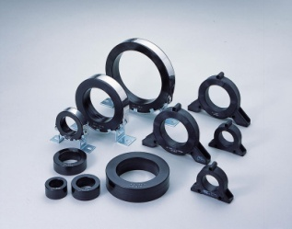
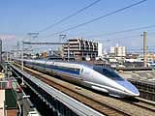
Main applications using FINEMET®
Transformer for high frequency
xEV
6.5% Si-Fe (t=0.1mm)
Si-Fe (t=0.23mm)
Mn-Zn Ferrite
Cut core
High efficiency
Noise filter for OBC,
Inverter, etc.
FINEMET (t=0.018mm)
Bm=0.1T, Gap=0mm
Reduction in size and weight
Wind and solar power
Wound core
Train
Shield sheet
Mobile phone
PROTERAL HP

Slide 15
B-H loop Options
By controlling shape of B-H loop
Variety of Flavors
Can be used for many purpose
PROTERIAL HP, Catalog

Slide 16

Example for PE ~High frequency transformers~
● Transformer suitable for
high-power, high-frequency SW circuits
App ex:
EV, PHEV Quick charger,
Welding machines,
medical equipment
Other inverter applications
Core Loss vs. Frequency
0.4m
CRGO (t=0.23mm)
B_{m}=0.1 T
6.5 % Si- Steel (t=0.1mm)
0.5m
Metglas® 2605SA1
0.6m
Size comparison vs 40 kVA commercial
freq. trans.
Volume 約 1/20
Weight 約 1/30
Mn-Zn Ferrite
0.3 m
FINEMET®
F3CC Series
FINEMET®
FT-3L Ring core
40 kVA 10 kHz High Frequency Transformer
Frequency (kHz)

Slide 17
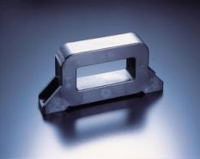
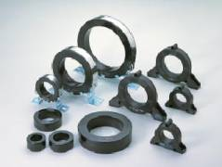
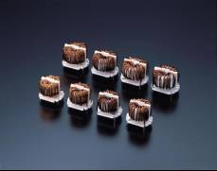

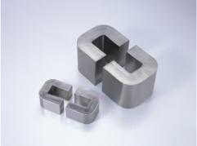
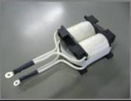
FINEMET & Metglas in EV&PHEV
2. FINEMET® Common Mode Choke
● Automotive charging circuit
/ Quick Charger
Noise Filter
Boost Converter
Boost Converter
PFC Circuit
Buttery
Inverter
Motor
～
1. FINEMET® Common Mode Choke
②FINEMET® Transformer
④Metglas® Reactor (Cut core)
Applications requires power density
PROTERAL HP

Slide 18
SMMs in medium frequencies
Development of High Fe content nanocrystalline alloys High B_{s} nanocrystalline alloy (Hi-B_{s} nano)

Slide 19
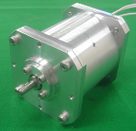
Applications which requires higher B_{s}
Choose materials with a good balance of high B_{s} and low losses to obtain high power density
at the expense of the best low-loss performance
B_{s}
Applications that use B-H loops throughout
Medium frequency (sub kHz – tens kHz)
Output will be determined not only by the B_{s}, but also by frequency.
Higher the frequency, higher the core loss i. e it creates heat.
If the coefficient of core loss is low, it is easier to pull out power by increasing driving frequency.
H
H_{c}
Neary full loop
Reactors
Motors
Hz
kHz
MHz
frequency
PROTERAL HP

Slide 20
Metallic SMMs on B_{m} vs. H_{c} map
B_{m}: determined by Saturation magnetic flux density B_{s}
& iron loss
1.5
Si steels
Fe –amorphous alloys
B_{m} vs. H_{c} Tradeoff
1.0
Operating magnetic flux density： B_{m} (T)
Smaller / higher power
Direction
Fe nanocrystalline alloys
(ex. Finemet® NanoparmTM)
high B_{m}
low H_{c}
0.5
10⁰
10¹
Coercivity : H_{c} (A/m)
low loss, high permeability
Notes:
This is a map of soft magnetic materials on Bm versus Hc plane
Here Bm stands for maximum operating flux density and Hc is coesevity
Bm are determined by saturation magnetic flux density Bs and iron loss
from this graph we can see Bm and Hc are tradeoff relation
what we want is mistrals go beyond this curve.

Slide 21
Soft magnetic materials on the B_{m} vs. H_{c} map
Two approaches
1.5
Si steels
Lower H_{c} in crystalline system?
Fe –amorphous alloys
or
1.0
Operating magnetic flux density： B_{m} (T)
Smaller / higher power
Higher B_{s} in
nano/random systems?
Fe nanocrystalline alloys
(ex. Finemet®)
Fe crystal has higher B_{s}
random structure exhibits good SMM
0.5
10⁰
10¹
Coercivity : H_{c} (A/m)
low loss, high permeability
Notes:
so on the map
there is two way to go
One reducing Hc of Si steels
or
making Bs high of nano-scale random system such as amorphous or nanocrystalline alloy

Slide 22
Concept of Materials Development
High B_{s} Nanocrystalline alloy
High B_{s}
↓
High Fe content
bcc Fe phase
Soft magn. prop.
Amorphous
or Nano
high Fe content nanocrystalline phase
High B_{s} & Low H_{c}
Notes:
so we aimed overwrapped concept of these two
high Fe content in nanocrystalline phase to realize High Bs and Low Hc at same time

Slide 23
Characters of FINEMET® composition
Composition of FINEMET® alloy
Fe_{73~75}Cu_{0.8~1.0}Nb_{2.6~3.0}Si_{13~16}B_{6~9}
(at.%)
Y. Yoshizawa, et. al.: Mater. Sci. Eng., A181/A182 (1994) 871-875.
Low Fe, relatively high Nb ⇒ Low B_{s}
Fe: source of magnetic moments
Nb: high number density of seeds & suppresses grain growth
Notes:
Let’s see characters of this composition
it has relatively low Fe content and high X elements
which makes Bs low

Slide 24
Annealing process of FINEMET®
（Fe-Cu-Nb-Si-B)
As-Q
Annealing process
Cu cluster
Primary crystals
grain growth
Our purpose: Zero magnetostriction
Fe-Si has negative magnetostriction
Residual amorphous phase has positive one
The balance of volume fraction of each phase
is important
bcc Fe-Si
Nb: Suppress Cu migration
Helps high number density of grain nucleation
Nb: Enhance thermal stability of residual amorphous phase
Suppress Grain growth
K. Hono, et al, Acta Mater. 47 (1999) 997.
Nb = indispensable element
Notes:
conventional nanocrystalline alloys are casted as an amorphous phase
at the early stage of annealing process, Cu clustering happens and these becomes seeds of primary crystals
they grow in the higher temperature
in this process Nb or Zr, I call X elements in this presentation, plays crucial roles
at the Cu clustering, X elements suppress the move of Cu atoms which help remaining high number density of seeds
and in the grain growth temperature, they go into residual amorphous phase and make it thermally stable
These X elements are necessary

Slide 25
Adopting Quick Anneal
Composition of FINEMET® alloy
Fe_{73~75}Cu_{0.8~1.0}Nb_{2.6~3.0}Si_{13~16}B_{6~9}
(at.%)
increase
decrease
at the expense of low magnetostriction, aim high B_{s}
Fe_{80~83}Cu_{0.8~1.0}Nb_{0.0~1.0}Si_{0~7}B_{12~15} (M = Nb, Mo …)
Roles of Nb elements
→ substituted by Quick Anneal
(flash anneal)
Approach 2. Rob migration time of Cu atoms
Notes:
So we made some modify of composition
increase Fe and decrease X elements like this
And substitute the roles of X element by Quick anneal

Slide 26
Cu clustering in Normal Annealing in new composition
As-Q
Clustering Temp. range
Cu migration
crystallization Temp.
Cu atom
Slowly passing Clustering temp. range
Cu atom can move long distance
clusters grow larger =
coarsening and decrease of number
Lack of seeds → grains grow large
Notes:
when normal anneal has been applied for that composition
it passes clustering temperature range slowly
then Cu can move long distance
cluster grow and they become larger and number density decreases
due to lack of seeds grains becomes large

Slide 27
Cu clustering in Quick Annealing
As-Q
Clustering Temp. range
Cu migration
crystallization temp.
passes clustering temp. instantly
Reaches crystallization temp.
before number density of clusters becomes low
High number density of seeds remains → fine nanocrystalline phase
Notes:
however by applying quick anneal
that is passing the clustering temperature fast
there is not enough time for Cu to travel long distance
and Cu clusters remains small and high number density
Thanks to high number density of seeds grains become small and uniform

Slide 28
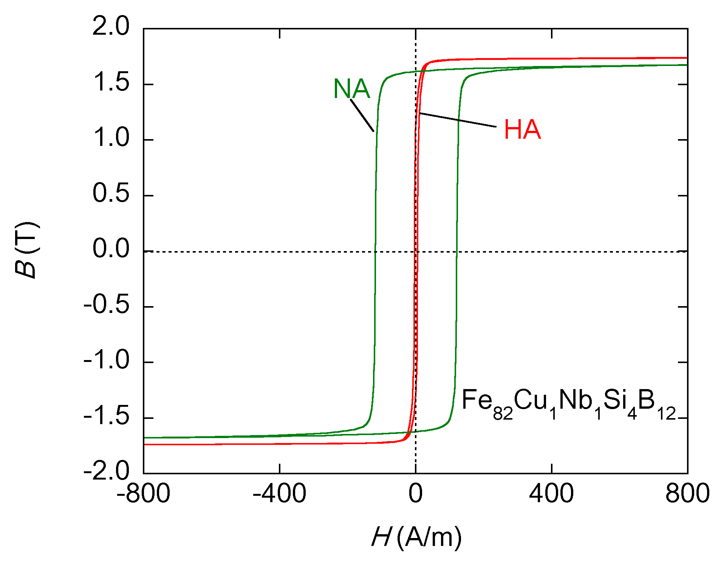
B-H loops of NA and QA ribbons
QA: Quick Anneal
QA
H_{c} < 3 A/m
NA: Normal anneal
H_{c} > 100 A/m
Low Nb, but high B_{s} & low H_{c}
M. Ohta, Y. Yoshizawa, JMMM 321 (2009) 2220–2224.
Notes:
we can see good soft magnetic properties
such as low Hc of 3 A/m with having Bs of 1.75 T

Slide 29
Position of developed high B_{s} nano alloys
Quick Anneal type
Primary Crystal type
1.5
Loss is 1/3 of Si-steels
Si steels
B_{s}・B_{m} are 10% higher than Fe-AM
Fe –amorphous alloys
Operating magnetic flux density： B_{m} (T)
Smaller / higher power
1.0
Quick annealing type may be suitable for industrial products
Fe nanocrystalline alloys
(ex. Finemet®)
0.5
If we can solve the processing issues
10⁰
10¹
Coercivity : H_{c} (A/m)
low loss, high permeability
Notes:
The developed materials can be put on the map like this
it exhibits one third of core loss of Si-Steel and 10% higher Bm than Fe-amorphous alloy
it seems quick anneal type alloy is suitable for industrial products, if we can solve the processing issues

Slide 30
Applications of Hi-B_{s} nano
Block core for a reactor
Motors

Slide 31
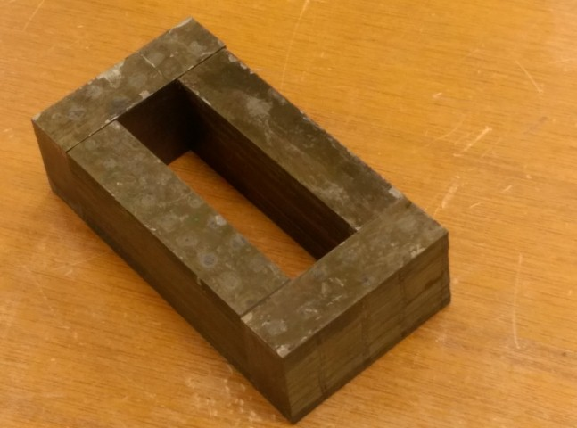
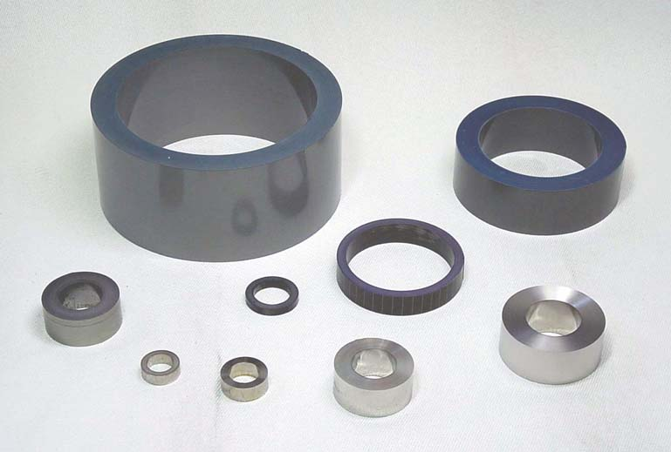
Core types
We want to search application field for this material.
Toroidal core
Block core
(laminated)
thickness of lamination
wound ribbon
Affects annealing
We cannot apply quick anneal to cores
Quick anneal first
then form the core
http://kuretake-denko.co.jp/pages/core_shurui/TOR.html
Easy to implement and easy to adapt to various applications
Notes:
These are the possible shape of applications
one, block cores may be impregnated
and toroidal core
but first of all, we found issue of annealing coursed by lamination thickness

Slide 32
Soft magnetic properties block cores
continuous Quick (flash) anneal
spool
laminate single strips
mold (impregnation)
83
19
cutting/Grinding/Etching
63
35
Block
HBN core
Form a circuit by 4 blocks
M. Ohta et al.: IEEE. Trans. Mag. (2018).
Notes:
so we prepared cores
first laminate single strips
mold it by resin
cutting grinding and etching had carried out
and we got a block
made core by 4 blocks

Slide 33
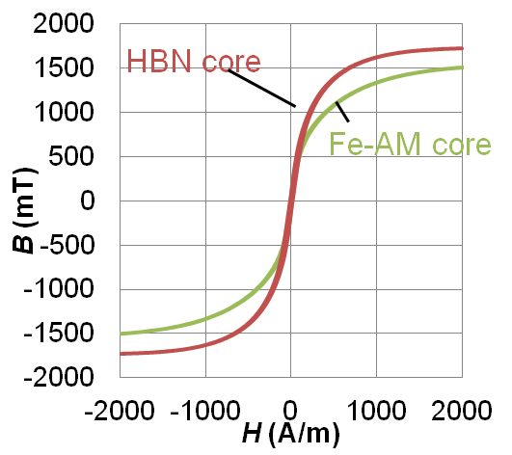
Soft magnetic properties block cores
Hi-B_{s} nano core shows high B₂₀₀₀
 | B_{2k} (T) | B_{s} (T) | B_{2k}/B_{s} | λ_{s} (10⁻⁶)
HBN | 1.73 | 1.75 | 99% | 14
Fe-AM | 1.50 | 1.57 | 96% | 27
Better saturation behavior in HBN.
Hi-B_{s} nano can handle 10~15% larger DC superposition current
M. Ohta et al.: IEEE. Trans. Mag. (2018).
Notes:
this is the B-H loop of High Bs nano block core
here we compered with that of Fe-based amorphous core
as we can see in the table
High Bs nano core shows more than 15% higher B at two thousand ampere per meter
that is because high Bs nano shows better saturation behavior of B
it reaches 99% of Bs at two thousand ampere per meter where Fe amorphous core is 96%

Slide 34
Soft magnetic properties block cores
2/3 of core loss of Fe-AM
Amorphous core is recognized as a sufficiently low-loss material
 | HBN core | Fe-AM core
P_{2/10k} (W/kg) | 8.5 | 12.7
P_{1/20k} (W/kg) | 5.4 | 7.7
M. Ohta et al.: IEEE. Trans. Mag. (2018).
Notes:
and here is the core loss
it shows two thirds of Fe based amorphous core

Slide 35
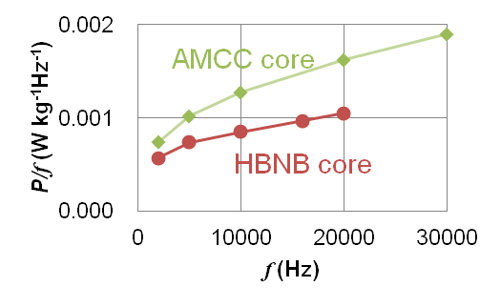
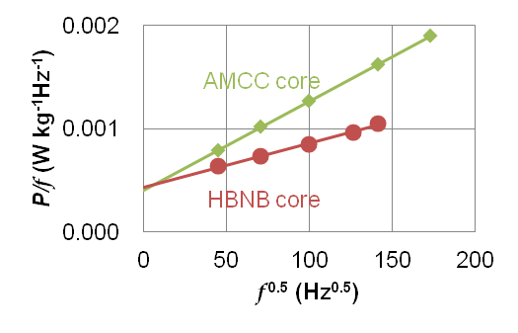
loss separation of block cores
P_{total}= P_{h}+P_{e}+P_{ex}
P_{h}∝f ¹
P_{e}∝f ²
P_{ex}∝f ^{1.5}
P = af + cf ²+ bf ^{1.5}
conventional plot: liner = eddy current
P/f = a + cf + bf ^{0.5}
c : negligibly small
Contribution of excess eddy current loss is dominant in medium f
b is strongly depending on pinning of domain wall
High B_{s} nano can be used in higher frequency
M. Ohta et al.: IEEE. Trans. Mag. (2018).
Notes:
when we do loss separation we can find big difference
the top graph is well known P per f versus f graph
and the bottom one is P per f versus f to the power of 0.5th graph
we see straight relation in bottom one
that means the contribution of excess or in other words anomalous eddy current loss is dominant in these frequencies

Slide 36
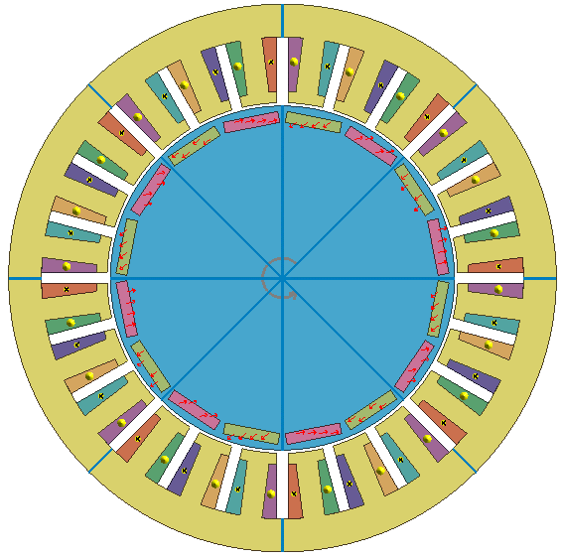
Comparison of core materials in Φ50mm motor
SPEC
item | value
Stator | Φ50 mm
Rotor | Φ31.4 mm
Gap | 0.3 mm
Thickness | 50 mm
Stator core Material | Amorphous (HB1M: PROERIAL)* Hi B_{s} Nano (PROTERIAL) Si-steel (35H300: Nippon Steel)
Output | 30 W (at 1000rpm) 300 W (at 10000rpm)
Voltage | Max. 200V
Current | Max. 3A
Stator
Coil
Permanent
magnet
Rotor
Cross section
*result from Shimane Univ
Motor

Slide 37
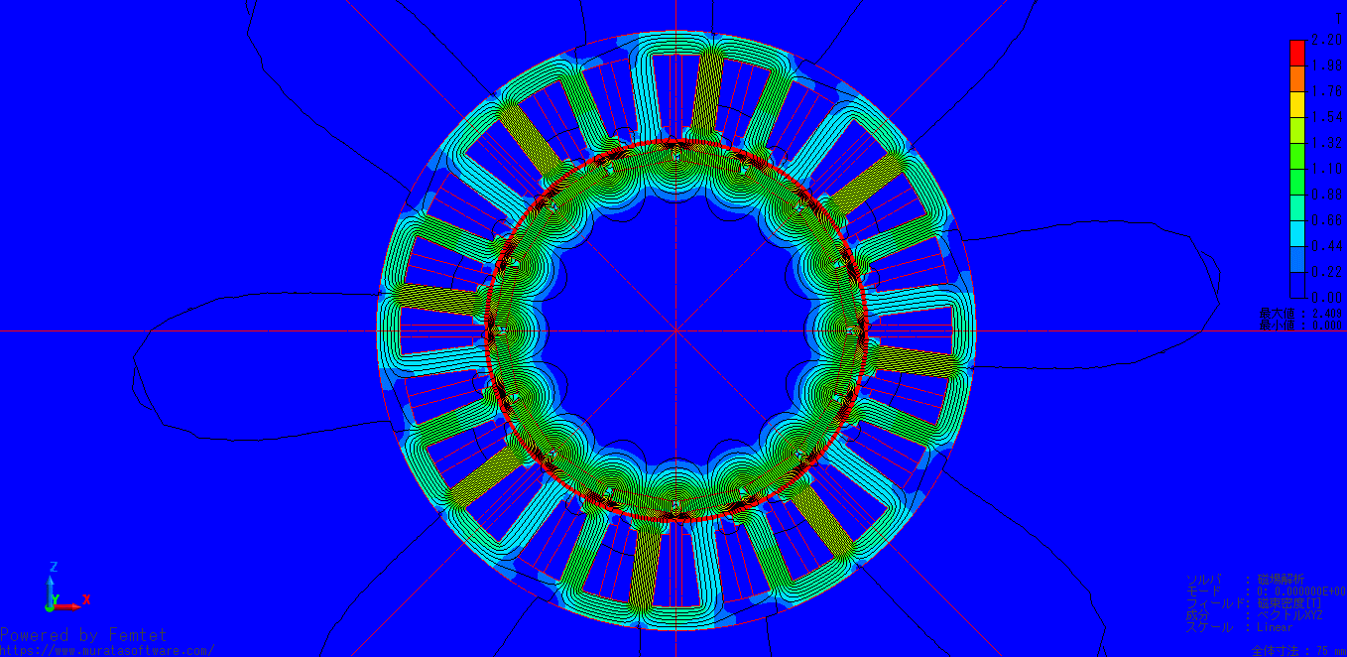
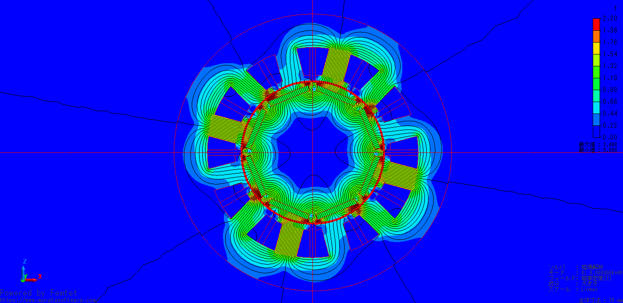
Result from Simulation
Amorphous, High B_{s} Nano:
@10000rpm(1333Hz) 85% lower core loss than Si-steel core
Similar torque
Analysis (@3.2 A)
2.2T
RPM | Core material | Torq (Nm) | Coil loss (W) | Core loss (W) | Total loss (W)
1000 min⁻¹ (133Hz) | Amorphous* | 1.03 | 3.06 | 0.147 | 3.207
 | Hi Bs Nano | 1.03 | 3.06 | 0.137 | 3.197
 | Si-steel | 1.02 | 3.06 | 1.175 | 4.235
10000 min⁻¹ (1333Hz) | Amorphous* | 1.03 | 3.06 | 2.917 | 5.977
 | Hi Bs Nano | 1.03 | 3.06 | 3.308 | 6.368
 | Si-steel | 1.02 | 3.06 | 39.82 | 42.88
Core
1/8
Total
25%↓
1.1T
0
Core
1/14
Total
85%↓
Contour Diagram
*result from Shimane Univ
Very meaningful difference can be expected!

Slide 38
Actual Measurement Results
No-load loss: equivalent to Amorphous and Hi-B_{s} nano teeth
In the light-load: efficiency of Amo/Hi-B_{s} nano…significant improvement
In the high-load: the proportion of coil loss increases, so the difference with Si-steel core decreases, and eventually the efficiency is reversed
There is an optimal design point for utilization
Hi B_{s} Nano
Si-Steel
Si-Steel
Amorphous*
Significant improve of efficiency
Hi B_{s} Nano
Amorphous*
@6000 rpm

Slide 39
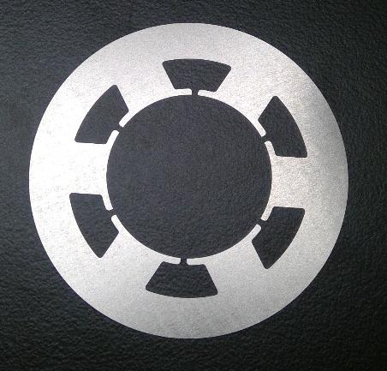
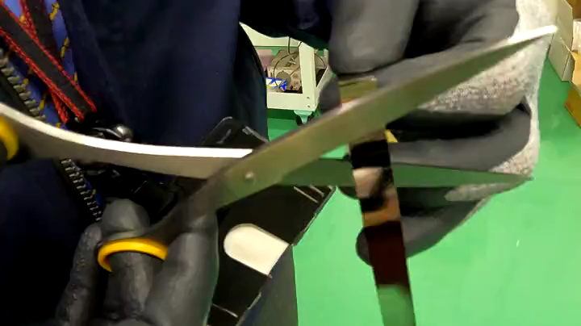
Issues of amorphous ribbon production
*nanocrystalline ribbons are also casted as amorphous phase
Punched (stamped) amorphous ribbon as a stator shape
No problem in shearing process
Otherwise
Shearing is easy!
Go simpler shape!
Thin & hard … requires more processes than thick & soft materials
But don’t forget that “thin” will lead to low eddy current loss in high freq.
Now we are trying to keep the number of strokes down in punching process

Slide 40
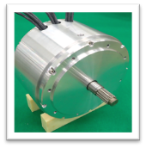
Radial Gap Motor
SPEC
Contents | IPM Motor
Power | 22kW(6000 rpm, 35 N･m) Max：66kW(7000 rpm，90 N･m)
Torque | 90 N･m
RPM | 20000r/min
Size | φ215×50mm（1.8L）
Weight | 13.6kg
Efficiency | 96.0%（Calculated value）
Si-steel (gray color)
Amorphous（pink）
High B_{s} nano（pink）
Stator
Si-steel
Si-steel
Rotor
Ref: All Si-steel
①Teeth of stator
(Amorphous)
Teeth of stator
(Hi Bs Nano)
The models, Cross section of ¼ of Motor
This simple shape can be prepared by shearing
Yuji Enomoto et .al: IEEJ Transactions on Industry Applications 143 (2022) pp.330–336

Slide 41
■No-load loss
Similar tendency
Yuji Enomoto et .al: IEEJ Transactions on Industry Applications 143 (2022) pp.330–336

Slide 42
Current vs. Torque
Si-Steel
Hi B_{s} Nano
Improvement of torque form amorphous
Amorphous
*The result could be expected
Yuji Enomoto et .al: IEEJ Transactions on Industry Applications 143 (2022) pp.330–336

Slide 43
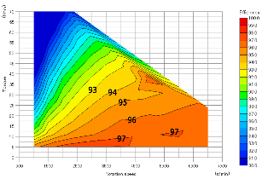
Efficiency map (tested result)
Si-steel
Teeth amorphous
Teeth Hi B_{s} Nano
Torque
93
94
95
96
RPM
Highest efficiency
Higher efficiency in wide condition
・Si-steel ＜ Amorphous (teeth) ＜ High B_{s} nano (teeth)
＊… So far, the high B_{s} nano is the best
Yuji Enomoto et .al: IEEJ Transactions on Industry Applications 143 (2022) pp.330–336

Slide 44
Remaining issues
Recycling
Punching processing

Slide 45
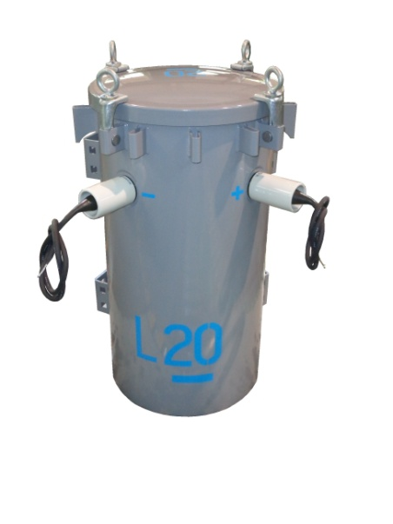
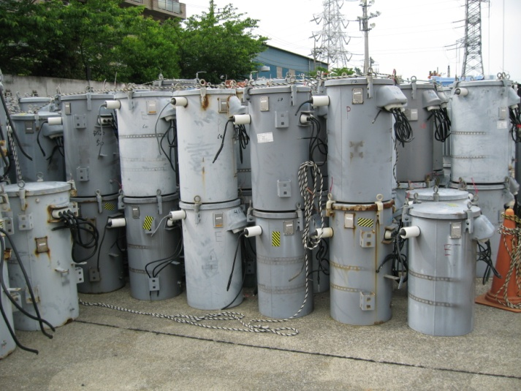
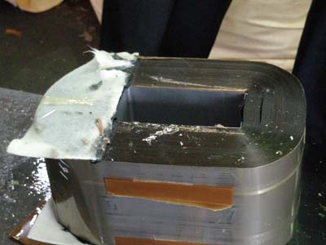

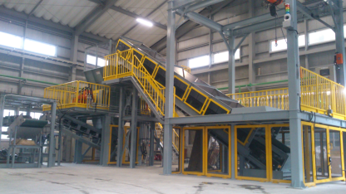
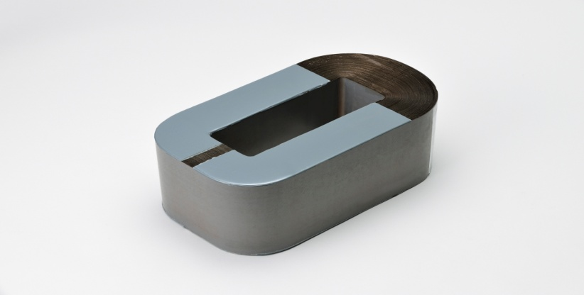
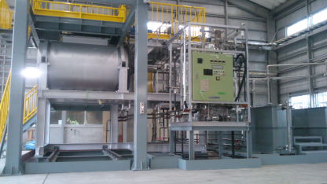
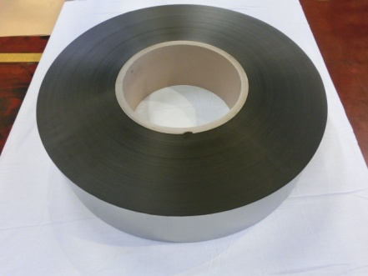
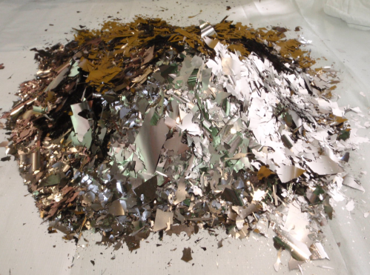
Recycle Flow of AMT (2013～)
Recycle of Amorphous Transformer
Recycle process
Capacity：50 MT/mo
（April, 2013～）
（産機）に掲載写真依頼中
Discard AMDT
AMDT
Retrieve AM core from AMDT
Energy saving and Resource circulation
Crush and Screen
AMDT core
Wash and Dry
AM ribbon
Crushed AM core
Page 19

Slide 46
Challenges for practical application
Challenges specific to Hi B_{s} nano
New machining process
or Consider the usage
Material | Assumed production process and challenges | Countermeasure
 |  | ・Shearing method ex：Teeth core
 |  | ・Processing methods other than stamping ⇒developing
 |  | Shrinkage evaluation & distortion reduction New heat treatment method New piece adhesion method
Anneal ribbon
↓ ↓
Lamination Shaping
↓ ↓
Shaping Lamination
Material
・Brittleness with crystallization
Machining
・Simpler Shape is easier
・Shrinkage
with crystallization
・High heating rate anneal
Shaping
↓
Parts anneal
↓
Lamination
・ In-plane variation of contraction
Material
Machining
・Handling issue

Slide 47
Conclusion
In present speak, the magnetic properties and their applications of the nanocrystalline alloy ribbons were introduced. Developed materials can be one of the best candidate for next generation power electronics materials from several kHz to MHz.
FINEMET® is designed having zero K and zero λ with high B_{s} owing to its nanocrystalline structure.
In high B_{s} nanocrystalline alloy, owing to high Fe content nanocrystalline structure, high B_{s} and low core loss can be realized simultaneously.

